Slide 1
Brokerage Industry
Regulatory Framework
Progress Overview
October 2016
Capital Market Analysis
Capital Market Institutes
Upcoming Developments
Concept of Brokerage
Regulatory Framework

Slide 2
Capital Market Institutions
Pakistan Stock Exchange – (PSX) (formerly: Karachi Stock Exchange Limited (KSE) was established on September 18, 1947. later in 2015 all tree stock exchanges (KSE, LSE & ISE) were merged as PSX (The Premier Stock Exchange with over 575 listed companies)
Pakistan Mercantile Exchange Ltd – In operations since 2007: Provides Futures contracts in commodities
Central Depository Company of Pakistan Limited (CDC) Established in 1997: Operates a book entry system to record and transfer securities in electronic form. The PSX is linked to Central Depository System (CDS). ~97% trades settled by the stock exchange are now handled through the CDS.
National Clearing Company of Pakistan Ltd (NCCPL)
Established in 2001: Provides clearing and settlement services by acting as a central and geographically neutral clearinghouse for PSX for book entry of securities.
Regulator
SECP
Capital Market Analysis
Regulatory Framework
Concept of Brokerage
Capital Markets Institutes
Upcoming Developments

Slide 3
Categories of Securities Broker
Trading Only: Category shall mean that a securities broker can only execute its proprietary trades and trades on behalf of its customers but cannot settle executed trades or keep custody of securities.
Trading and Self-Clearing: category shall mean the securities broker can execute as well as settle its proprietary trade and trades executed on behalf of its customer’s and can keep custody of securities owned by its and its customer subject to such conditions as may be imposed by the Commission.
Trading and Clearing: category shall mean that a security broker can execute as well as settle its proprietary trades and trades executed on behalf of its customers, in addition such brokers can settle trades for other securities brokers and their customers
‘Trading Only” category shall be required to transfer its clearing, settlement and custody functions within a transition period of six months or an extended time period as may be allowed by the Commission. Such securities broker, during the transition period, shall comply with requirement applicable to the “Trading and Self-Clearing” category.
Securities Brokers Regulation 2016: Notification date 24th June, 2016
Total number of registered brokers are above 350

Slide 4
Financial Resources Requirement
Category of securities broker | Paid up Capital -PKR million- | Net worth PKR million | Minimum Net Capital Balance PKR million | Within year 1 from obtaining fresh license | Within year 2 from obtaining fresh license
Trading Only | 15 | 15 | 2.5 | Securities broker to meet at least 50% the amount less than the minimum specified requirement Securities broker to meet at lest 50% of the amount less than the minimum specified requirement | Securities broker to meet at remaining amount less than the minimum specified Securities broker to meet remaining amount less than the minimum specified requirement
Trading and Self Clearing | 35 | 35 | 5
Trading and Clearing | 100 | 100 | 10

Slide 5
Broker Activities
Brokerage activities:
Brokerage
Equity Brokerage (Listed and Unlisted Securities), Fixed Income Brokerage, Commodity Brokerage
Corporate Finance
Financial Advisory
Treasury Operations (Fixed Income & Money Market)
Research
Underwriting
Leverage products
(Margin Financing, Margin Trading, Securities Lending and Borrowing)
Brokerage clients classification:
Foreign
Institutional (Corporates and Financial Institutions)
Retail.
Capital Market Analysis
Capital Market Institutes
Upcoming Developments
Brokerage Industry
Regulatory Framework

Slide 6
Trading Options – Brokerage Revenue streams in Equity Market
Ready Market: All listed companies shares traded during regular market time. Regular market works on T+2 settlement system.
Futures Market: Involves purchase and sale of securities at some future date (normally within one calendar month), at a price fixed today.
Margin Trading System: Purchase of securities in ready market by equity participation.
Margin Financing: Financing against net ready market purchases and may be obtained as per agreed Financier Participation Ratio.
Securities Lending & Borrowing (SLB): Temporary exchange of securities with an obligation to re-deliver the same securities in the same number and at an agreed premium on a future date.
Capital Market Analysis
Capital Market Institutes
Upcoming Developments
Brokerage Industry
Regulatory Framework

Slide 7
Leveraged Products
Margin Financing (MF)
MF facility is made available to all brokers against net ready market purchases of their clients and proprietary positions.
Financier Participation Ratio (commonly 75%). However, minimum of 25% or VaR whichever is higher should be contributed by financee.
Maximum mark-up rate in MTS Market is KIBOR+8%.
Eligible Financees: All Broker Clearing Members.
Eligible Financiers: A member of a Stock Exchange; a banking company; and a company, corporation or institution.
No MtM losses procedure. No roll over.
Contract days 120 days.
Margin Trading System (MTS)
Maximum mark-up rate in MTS Market is KIBOR+8%
Equity participation: Financee (15%); Financier (85%).
Eligible Financees: All Broker Clearing Members.
Eligible Financiers: A member of a Stock Exchange; a banking company; and a company, corporation or institution.
Marked-to-Market (MtM) losses on daily basis in Cash only till the settlement of the entire MT Contract.
MT Contract not exceed from 60 calendar days. Every 15th calendar day, MTS will automatically release one 4th quantity of the MT Contract Value.
Rollover is allowed in MTS.
Securities Lending & Borrowing (SLB)
May be utilized by the borrowers to avoid delivery failure in ready market or to make a short sale.
SLB is done through an automated platform provided by NCCPL to lenders and borrowers for placing offers and bids on un-disclosed manner.
Eligible Participants: A member of a Stock Exchange; a banking company; and a company, corporation or institution.
Max Premium of SLB KIBOR+8%.
Contract period is maximum for 22 working days.
On Settlement Day, the lender delivers the securities lent and borrower pays the total amount of borrowed securities.
Capital Market Analysis
Capital Market Institutes
Upcoming Developments
Brokerage Industry
Regulatory Framework

Slide 8
Order / Transaction Types
Market Order: Only order quantity is sent and trade is executed at the market price.
Limit Order: Limit price and order quantity are sent by the investor and trade is executed by the exchange when the market price reaches the price specified.
Stop Loss Order: A request to sell a security once the market price reaches or falls below a customer-specific price. Once the target price has been reached or surpassed, the order becomes a “market” order. Stop-loss orders are only available when selling a security to close a position.
Short sell: Selling securities owned by the seller in anticipation of repurchasing them at a lower price.
Capital Market Analysis
Capital Market Institutes
Upcoming Developments
Brokerage Industry
Regulatory Framework

Slide 9
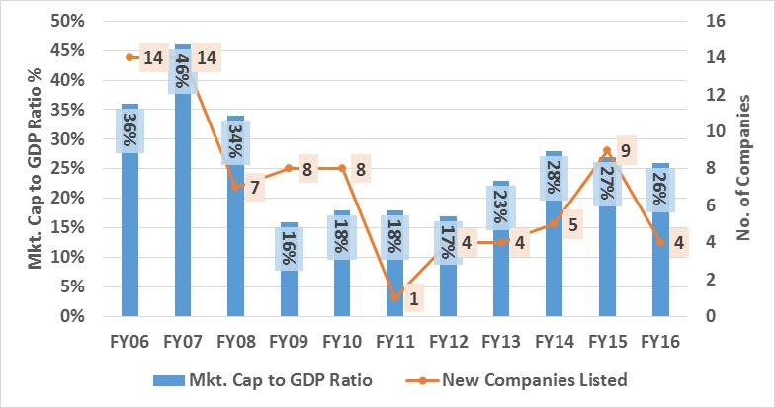
Equity Market –Analysis
Capital Market Analysis
Capital Market Institutes
Upcoming Developments
Brokerage Industry
Regulatory Framework

Slide 10
Foreign & Local Trading Activity in Stock Market
Capital Market Analysis
Capital Market Institutes
Upcoming Developments
Brokerage Industry
Regulatory Framework

Slide 11
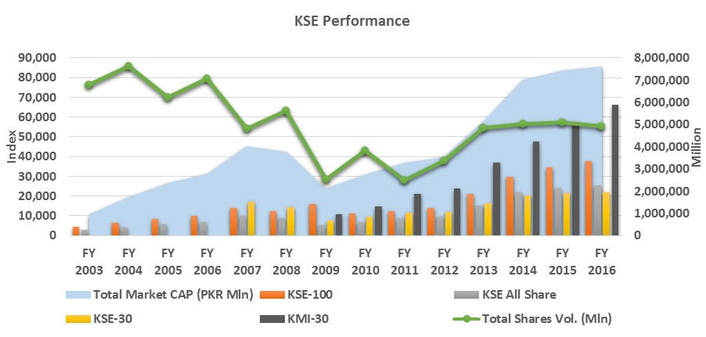
Equity Market - Indexes Analysis
Capital Market Analysis
Capital Market Institutes
Upcoming Developments
Brokerage Industry
Regulatory Framework

Slide 12
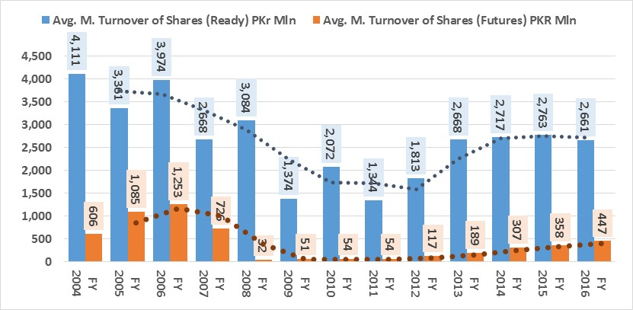
Equity Market – Turnover Analysis
Capital Market Analysis
Capital Market Institutes
Upcoming Developments
Brokerage Industry
Regulatory Framework

Slide 13
Equity Market – Active UINs
Capital Market Analysis
Capital Market Institutes
Upcoming Developments
Brokerage Industry
Regulatory Framework

Slide 14
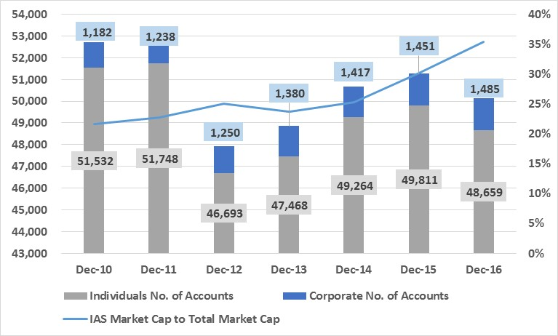
Equity Market – Investor Account Services (IAS)
Capital Market Analysis
Capital Market Institutes
Upcoming Developments
Brokerage Industry
Regulatory Framework

Slide 15
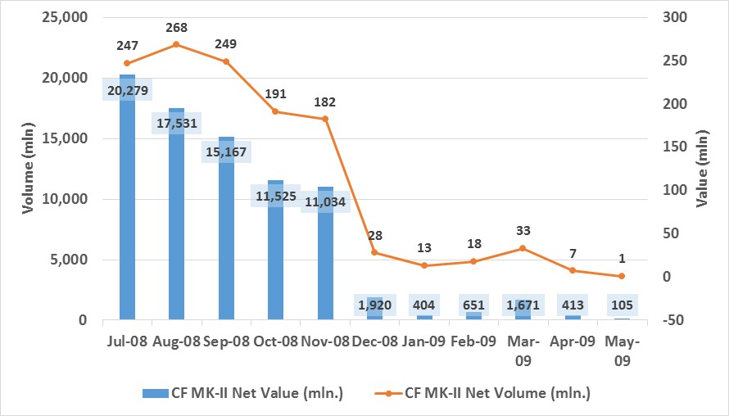
Equity Market – Leveraged Products During 2008 – 2009 Crisis
Capital Market Analysis
Capital Market Institutes
Upcoming Developments
Brokerage Industry
Regulatory Framework

Slide 16
Equity Market – Leveraged Products Post 2008 Crisis
Capital Market Analysis
Capital Market Institutes
Upcoming Developments
Brokerage Industry
Regulatory Framework

Slide 17
Upcoming Developments
Foreign Strategic Investor in the Pakistan Stock Exchange
Reclassification of Pakistan in Emerging Markets Index
Capital Market Analysis
Capital Market Institutes
Upcoming Developments
Brokerage Industry
Regulatory Framework

Slide 18
Analysts | Rai Umar Zafar Manager Ratings +92 42 3586 9504 rai.umar@pacra.com | Ahmed Sheikh & Mohsin Naseer Financial Analyst +92 42 3586 9504 Usama.liaquat@pacra.com
DISCLAIMER
PACRA has used due care in preparation of this document. Our information has been obtained from sources we consider to be reliable but its accuracy or completeness is not guaranteed. The information in this document may be copied or otherwise reproduced, in whole or in part, provided the source is duly acknowledged. The presentation should not be relied upon as professional advice.

